Slide 1
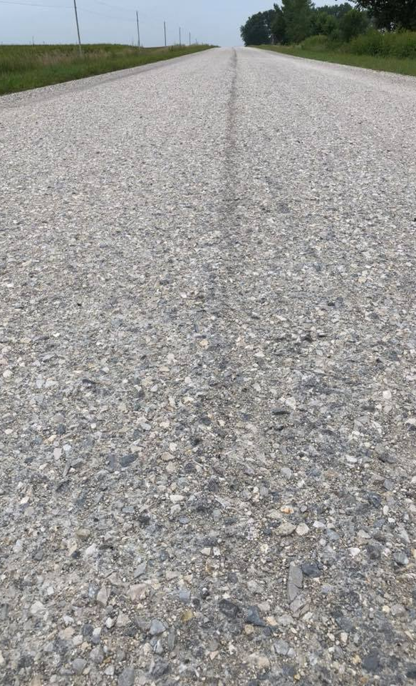
TRANSPORTATION
IMPROVEMENT
BOARD
OTTA SEAL
Using High Float Emulsions
(HF-150)

Slide 2
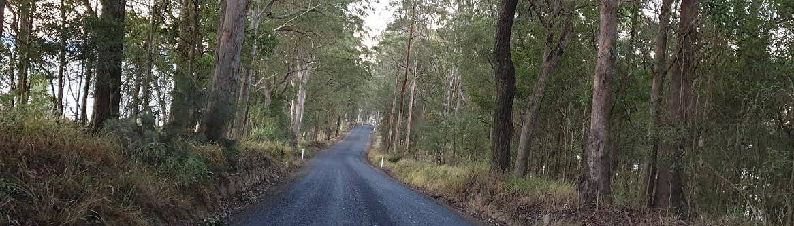
What is Otta Seal?
Transportation Improvement Board | Otta Seal Overview
Otta Seal is a surface treatment that uses a medium of rock that interlocks with each other like hotmix. It is made by placing the rock medium on top of a thick application of relatively soft, bituminous binding agent such as HF-150¹. Otta Seal can look like gravel after immediate installation, but over time the black oils will work their way up creating the appearance of a normally paved surface.
¹Johnson, G., & Pantelis, J. 2003, 2008. Otta Seal Surfacing of Aggregate Roads. http://www.dot.state.mn.us/materials/bituminousdocs/Pavement%20Maintenance/OttaSeal_4-pagerMRR_2008.pdf

Slide 3
Recap of Chip Seal
Transportation Improvement Board | Chip Seal Overview
Chip Seal is one layer of clean rock that requires enough oil to secure it. It is one of the oldest and most common street-surfacing methods¹.
¹Chip Seal Brochure. https://static.spokanecity.org/documents/projects/2021-residential-chip-seal/chip-seal-brochure.pdf

Slide 4
Advantages of Otta Seal
Otta Seal
Chip Seal
Costs less than washed rock, saving money for agencies
Less brittle at low temperatures, less prone to temperature related failure
Does not bleed like base AC emulsions
Holds rock medium better
Fines in the rock can fill in cracks and voids
Otta seal can last 8 to 15 years or more with proper maintenance
While effective, the medium is more expensive and less accessible to smaller agencies and communities
More susceptible to weather and traffic damage
Lasts about half the lifespan of Otta seal
Transportation Improvement Board | Otta Seal Advantages
Asphalt Surfacing. https://web.archive.org/web/20120426011304/http://www.cflhd.gov/programs/techDevelopment/pavement/context-roadway-
surfacing/documents/roadway-surfacing-photos/ch1-c-asphalt.pdf
Johnson, G., & Pantelis, J. 2003, 2008. Otta Seal Surfacing of Aggregate Roads. http://www.dot.state.mn.us/materials/bituminousdocs0
/Pavement%20Maintenance/OttaSeal_4-pagerMRR_2008.pdf

Slide 5
Process for Single Shot Otta Seal on
Paved Surface
Transportation Improvement Board | Single Shot on Paved Surface
Step One
Step Two
Step Three
Lay down materials
Apply oil
Allow oil to penetrate
Apply cover stone
Roll with two rollers
One roller should be a steal drum
This seals the treatment
Return after three weeks and sweep excess rock
Photos from Creston, WA Otta Seal Project!

Slide 6
Process for Double Shot Otta Seal on
Gravel Surface
Transportation Improvement Board | Double Shot on Gravel Surface
Step One
Step Two
Step Three
Step Four
Lay down materials
Apply oil
Allow oil to penetrate
Apply cover stone
Roll with two rollers
One roller should be a steal drum
This seals the treatment
After 7-10 days, apply second layer of materials
Place with oil
Apply cover stone
Return after three weeks and sweep excess rock

Slide 7
Differences in Oils
High Float Emulsion (HF-150)
Conventional Emulsions
Easier to handle than cationic oils
More forgiving emulsion
Works well with crushed stone aggregate
Saves money due to materials used
Sets much more quickly
Relies on kerosene evaporation
Works with more expensive, washed aggregate
Transportation Improvement Board | Differences in Oils

Slide 8
Application Rate for Otta Seal on
Paved Surface
Undiluted Asphalt (gal/sy)
Aggregate Application
(lbs/sy)
Aggregate Size
0.45 - 0.50
Crushed Cover Stone
30 - 35
Process for Otta Seal on a Paved Surface
Apply 0.45-0.50 gal/sy HF-150 to compacted gravel surface.
Let it penetrate.
Apply 30-35 lbs/sy cover stone.
Due to low volume traffic, ensure extra rolling effort with two rollers (at least one shall be a steel drum) to seat the cover.
Optional- After 3 weeks of placement, sweep excess rock.
Transportation Improvement Board | Otta Seal on a Paved Surface

Slide 9
Application Rate for Otta Seal on
Gravel Surface
Aggregate Application
(lbs/sy)
Undiluted Asphalt (gal/sy)
Aggregate Size
First Application
0.45 - 0.50
Crushed Cover Stone
30 - 35
Second Application
0.40 - 0.44
Crushed Cover Stone
30 - 32
Process for Otta Seal on a Surface
Apply 0.45-0.50 gal/sy HF-150 to compacted gravel surface.
Let it penetrate.
Apply 30-35 lbs/sy cover stone.
Due to low volume traffic, ensure extra rolling effort with two rollers (at least one shall be a steel drum) to seat the cover.
The second application should be applied 7-10 days after the first application.
Second application- Seal again with 0.40-0.44 gal/sy HF-150
Apply 30-32 lbs/sy cover stone.
Again, extra rolling effort which includes a steel drum roller.
Optional- After 3 weeks of placement of second application, sweep excess rock.
Transportation Improvement Board | Otta Seal on a Gravel Surface

Slide 10
Additional Specifications
Crushed Cover Stone Specifications
Oil Specifications for HFE-150
Test
Requirement
Min. F
Max. F
3/4” Square Sieve
100% passing
130
175
5/8” Square Sieve
95-100% passing
No. 4
20-45% passing
No. 200
0-7.5% passing
% Fracture by weight, min.
75%
Sand Equivalent
40 min
Static Stripping Test
Pass

